Slide 1
Trees
A tree is a connected undirected graph with no simple circuits.

Slide 2
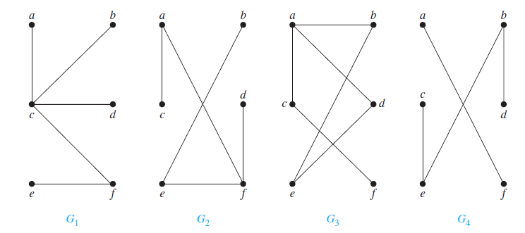
As tree cannot have a simple circuit, a tree cannot contain multiple edges or loops. Therefore any tree must be a simple graph.
G1 and G2 are trees
G3 have circuit, no tree.
G4 is not connected graph

Slide 3
Some Definitions (components)
Theorem : An undirected graph is a tree if and only if there is a unique simple path between any two of its vertices.
Tree Forest- Collection of trees is forest.
Rooted Trees- A rooted tree is a tree in which one vertex has been designated as the root and every edge is directed away from the root.
If v is a vertex in T other than the root, the parent of v is the unique vertex u such that there is a directed edge from u to v.
When u is the parent of v, v is called a child of u.
Vertices with the same parent are called siblings.

Slide 4
The ancestors of a vertex other than the root are the vertices in the path from the root to this vertex, excluding the vertex itself and including the root (that is, its parent, its parent’s parent, and soon, until the root is reached).
The descendants of a vertex v are those vertices that have v as an ancestor.
A vertex of a rooted tree is called a leaf if it has no children. Vertices that have children are called internal vertices. The root is an internal vertex unless it is the only vertex in the graph, in which case it is a leaf.
If a is a vertex in a tree, the subtree with a as its root is the subgraph of the tree consisting of a and its descendants and all edges incident to these descendants.

Slide 5
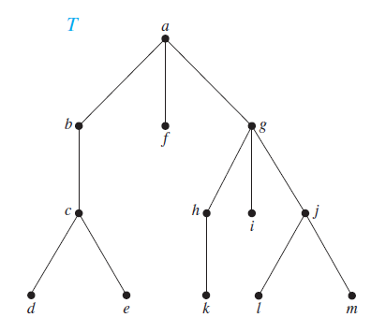
The parent of c is b. The children of g are h, i, and j . The siblings of h are i and j .
The ancestors of e are c, b, and a. The descendants of b are c, d, and e.
The internal vertices are a, b, c, g, h, and j . The leaves are d, e, f , i, k, l, and m.

Slide 6
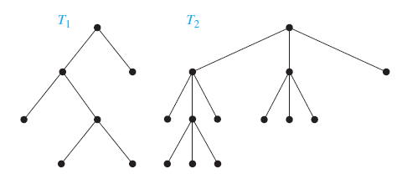
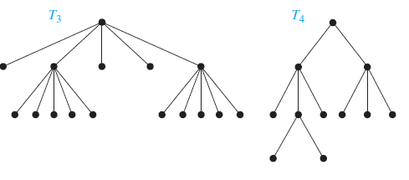
m-ary Trees
A rooted tree is called an m-ary tree if every internal vertex has no more than m children.
The tree is called a full m-ary tree if every internal vertex has exactly m children. An m-ary tree with m = 2 is called a binary tree.

Slide 7
Properties of Trees
Theorem: A tree with n vertices has n − 1 edges.
Theorem: A full m-ary tree with i internal vertices contains n = mi + 1 vertices.
Theorem: A full m-ary tree with
n vertices has i = (n − 1)/m internal vertices and
l = [(m − 1)n + 1]/m leaves,
i internal vertices has n = mi + 1 vertices and
l = (m − 1)i + 1 leaves,
l leaves has n = (ml − 1)/(m − 1) vertices and
i = (l − 1)/(m − 1) internal vertices.

Slide 8
Suppose that someone starts a chain letter. Each person who receives the letter is asked to send it on to four other people. Some people do this, but others do not send any letters. How many people have seen the letter, including the first person, if no one receives more than one letter and if the chain letter ends after there have been 100 people who read it but did not send it out? How many people sent out the letter?
Solution: The chain letter can be represented using a 4-ary tree. The internal vertices correspond to people who sent out the letter, and the leaves correspond to people who did not send it out.
Because 100 people did not send out the letter, the number of leaves in this rooted tree is l = 100. Hence, part (iii) of Theorem, shows that the number of people who have seen the letter is
n = (4 · 100 − 1)/(4 − 1) = 133.
Also, the number of internal vertices is 133 − 100 = 33,
so 33 people sent out the letter.

Slide 9
Applications of Trees Binary tree
A binary tree is a tree where all nodes have at most two children.
1
2
1
3
4
2
3
5
4
5
6
7
6
7

Slide 10
Which of the following are Binary Search trees
5
BINARY SEARCH TREE
8
4
8
5
11
1
7
11
2
7
6
10
18
3
4
15
20
NOT A
BINARY SEARCH TREE
21

Slide 11
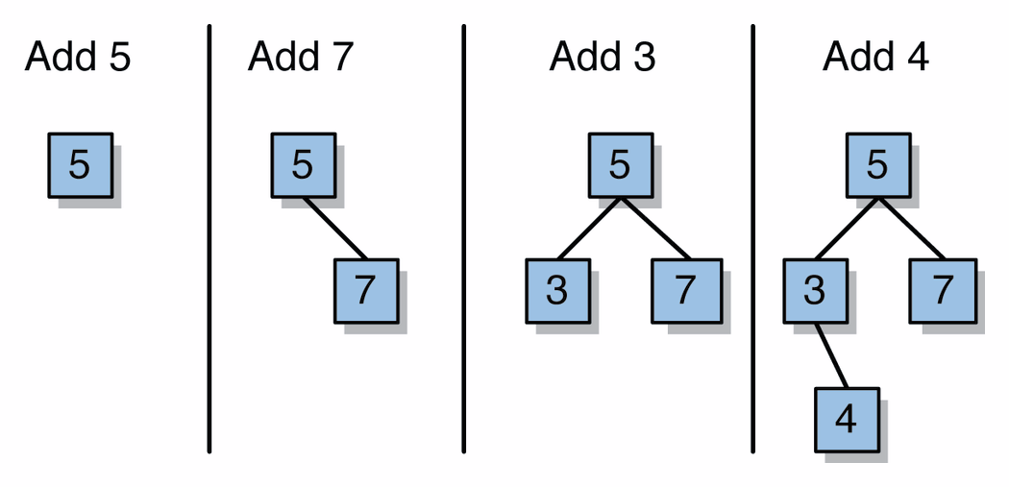
Adding as element to BST(Binary Search Tree)

Slide 12
findMin, findMax
To find the maximum element in the BST, we follow right children until we reach NULL.
To find the minimum element in the BST, we follow left children until we reach NULL.
5
4
8
1
7
11
3

Slide 13
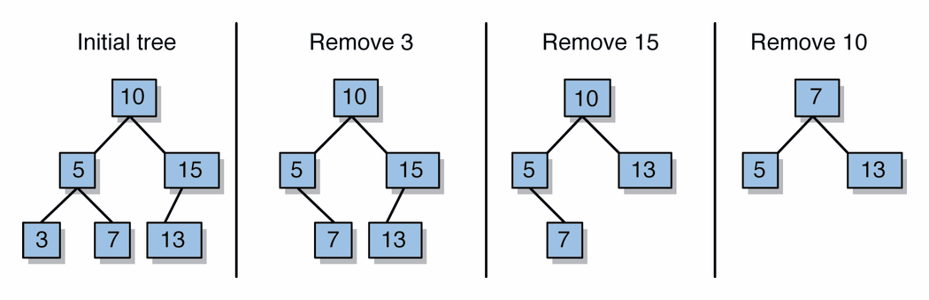
Removing elements from a binary search tree

Slide 14
Removing an item disrupts the tree structure.
Basic idea:
find the node that is to be removed.
Then “fix” the tree so that it is still a binary search tree.
Remove node and replace it with its successor or predecessor (whichever more convenient)
Three cases:
node has no children
node has one child
node has two children

Slide 15
5
5
4
8
4
8
1
7
11
1
7
11
3
3

Slide 16
Replace the node with its successor. Then remove the successor from the tree.
7
5
4
8
4
8
1
7
11
1
7
11
3
3

Slide 17
Case 1: removing a node with 2 EMPTY SUBTREES
Delete it immediately
parent
7
cursor
5
9
4
6
8
10
7
Removing 4
replace the link in the parent with null
5
9
6
8
10

Slide 18
Case 2: removing a node with 2 SUBTREES
replace the node's value with the max value in the left subtree
delete the max node in the left subtree
What other element
can be used as
replacement?
Removing 7
cursor
cursor
7
6
5
9
5
9
4
6
8
10
4
8
10

Slide 19
Case 3: removing a node with 1 EMPTY SUBTREE
the node has no left child:
link the parent of the node to the right (non-empty) subtree
parent
parent
7
7
cursor
5
9
cursor
5
9
6
8
10
6
8
10

Slide 20
Height of BST
n-node BST: Worst case depth: n-1.
Claim: The maximum number of nodes in a binary tree of height h is 2^{h+1} – 1.
Proof: The proof is by induction on h. For h = 0, the tree has one node, which is equal to 2⁰⁺¹ – 1.
Suppose the claim is true for any tree of height h. Any tree of height h+1 has at most two subtrees of height h. By the induction hypothesis, this tree has at most 2 (2^{h+1} – 1)+1 = 2^{h+2} – 1.
If we have a BST of n nodes and height h, then by the Claim,
n ≤ 2^{h+1} – 1. So, h ≥ log (n+1) – 1.

Slide 21
Spanning tree
Let G be a simple graph. A spanning tree of G is a subgraph of G that is a tree containing every vertex of G.
A simple graph with a spanning tree must be connected, because there is a path in the spanning tree between any two vertices. The converse is also true; that is, every connected simple graph has a spanning tree.

Slide 22
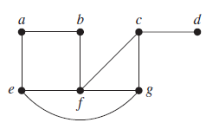
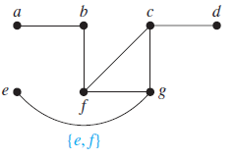
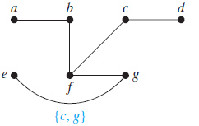
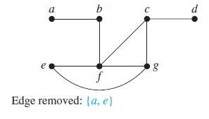
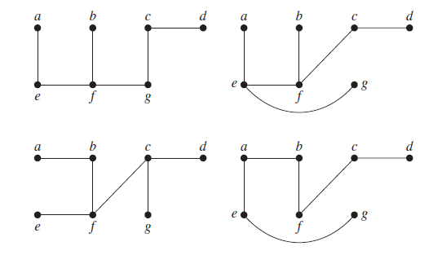
Find a spanning tree of the simple graph G
solution

Slide 23
Minimum Spanning Tree (MST)
A Minimum Spanning Tree (MST) is a subgraph of an undirected graph such that the subgraph spans (includes) all nodes, is connected, is acyclic, and has minimum total edge weight

Slide 24
Algorithm Characteristics
Both Prim’s and Kruskal’s Algorithms work with undirected graphs
Both work with weighted and unweighted graphs but are more interesting when edges are weighted
Both are greedy algorithms that produce optimal solutions

Slide 25
Prim’s Algorithm
Similar to Dijkstra’s Algorithm except that d_{v} records edge weights, not path lengths

Slide 26
Walk-Through
2
Initialize array
F
3
C
 | K | d_{v} | p_{v}
A | F | ∞ | −
B | F | ∞ | −
C | F | ∞ | −
D | F | ∞ | −
E | F | ∞ | −
F | F | ∞ | −
G | F | ∞ | −
H | F | ∞ | −
10
A
7
3
8
4
4
B
18
D
9
10
H
2
25
3
G
E
7

Slide 27
2
Start with any node, say D
F
3
C
 | K | d_{v} | p_{v}
A
B
C
D | T | 0 | −
E
F
G
H
10
A
7
3
8
4
4
B
18
D
9
10
H
2
25
3
G
E
7

Slide 28
2
Update distances of adjacent, unselected nodes
F
3
C
 | K | d_{v} | p_{v}
A
B
C |  | 3 | D
D | T | 0 | −
E |  | 25 | D
F |  | 18 | D
G |  | 2 | D
H
10
A
7
3
8
4
4
B
18
D
9
10
H
2
25
3
G
E
7

Slide 29
2
Select node with minimum distance
F
3
C
 | K | d_{v} | p_{v}
A
B
C |  | 3 | D
D | T | 0 | −
E |  | 25 | D
F |  | 18 | D
G | T | 2 | D
H
10
A
7
3
8
4
4
B
18
D
9
10
H
2
25
3
G
E
7

Slide 30
2
Update distances of adjacent, unselected nodes
F
3
C
 | K | d_{v} | p_{v}
A
B
C |  | 3 | D
D | T | 0 | −
E |  | 7 | G
F |  | 18 | D
G | T | 2 | D
H |  | 3 | G
10
A
7
3
8
4
4
B
18
D
9
10
H
2
25
3
G
E
7

Slide 31
2
Select node with minimum distance
F
3
C
 | K | d_{v} | p_{v}
A
B
C | T | 3 | D
D | T | 0 | −
E |  | 7 | G
F |  | 18 | D
G | T | 2 | D
H |  | 3 | G
10
A
7
3
8
4
4
B
18
D
9
10
H
2
25
3
G
E
7

Slide 32
2
Update distances of adjacent, unselected nodes
F
3
C
 | K | d_{v} | p_{v}
A
B |  | 4 | C
C | T | 3 | D
D | T | 0 | −
E |  | 7 | G
F |  | 3 | C
G | T | 2 | D
H |  | 3 | G
10
A
7
3
8
4
4
B
18
D
9
10
H
2
25
3
G
E
7

Slide 33
2
Select node with minimum distance
F
3
C
 | K | d_{v} | p_{v}
A
B |  | 4 | C
C | T | 3 | D
D | T | 0 | −
E |  | 7 | G
F | T | 3 | C
G | T | 2 | D
H |  | 3 | G
10
A
7
3
8
4
4
B
18
D
9
10
H
2
25
3
G
E
7

Slide 34
2
Update distances of adjacent, unselected nodes
F
3
C
 | K | d_{v} | p_{v}
A |  | 10 | F
B |  | 4 | C
C | T | 3 | D
D | T | 0 | −
E |  | 2 | F
F | T | 3 | C
G | T | 2 | D
H |  | 3 | G
10
A
7
3
8
4
4
B
18
D
9
10
H
2
25
3
G
E
7

Slide 35
2
Select node with minimum distance
F
3
C
 | K | d_{v} | p_{v}
A |  | 10 | F
B |  | 4 | C
C | T | 3 | D
D | T | 0 | −
E | T | 2 | F
F | T | 3 | C
G | T | 2 | D
H |  | 3 | G
10
A
7
3
8
4
4
B
18
D
9
10
H
2
25
3
G
E
7

Slide 36
2
Update distances of adjacent, unselected nodes
F
3
C
 | K | d_{v} | p_{v}
A |  | 10 | F
B |  | 4 | C
C | T | 3 | D
D | T | 0 | −
E | T | 2 | F
F | T | 3 | C
G | T | 2 | D
H |  | 3 | G
10
A
7
3
8
4
4
B
18
D
9
10
H
2
25
3
G
E
7
Table entries unchanged

Slide 37
2
Select node with minimum distance
F
3
C
 | K | d_{v} | p_{v}
A |  | 10 | F
B |  | 4 | C
C | T | 3 | D
D | T | 0 | −
E | T | 2 | F
F | T | 3 | C
G | T | 2 | D
H | T | 3 | G
10
A
7
3
8
4
4
B
18
D
9
10
H
2
25
3
G
E
7

Slide 38
2
Update distances of adjacent, unselected nodes
F
3
C
 | K | d_{v} | p_{v}
A |  | 4 | H
B |  | 4 | C
C | T | 3 | D
D | T | 0 | −
E | T | 2 | F
F | T | 3 | C
G | T | 2 | D
H | T | 3 | G
10
A
7
3
8
4
4
B
18
D
9
10
H
2
25
3
G
E
7

Slide 39
2
Select node with minimum distance
F
3
C
 | K | d_{v} | p_{v}
A | T | 4 | H
B |  | 4 | C
C | T | 3 | D
D | T | 0 | −
E | T | 2 | F
F | T | 3 | C
G | T | 2 | D
H | T | 3 | G
10
A
7
3
8
4
4
B
18
D
9
10
H
2
25
3
G
E
7

Slide 40
2
Update distances of adjacent, unselected nodes
F
3
C
 | K | d_{v} | p_{v}
A | T | 4 | H
B |  | 4 | C
C | T | 3 | D
D | T | 0 | −
E | T | 2 | F
F | T | 3 | C
G | T | 2 | D
H | T | 3 | G
10
A
7
3
8
4
4
B
18
D
9
10
H
2
25
3
G
E
7
Table entries unchanged

Slide 41
2
Select node with minimum distance
F
3
C
 | K | d_{v} | p_{v}
A | T | 4 | H
B | T | 4 | C
C | T | 3 | D
D | T | 0 | −
E | T | 2 | F
F | T | 3 | C
G | T | 2 | D
H | T | 3 | G
10
A
7
3
8
4
4
B
18
D
9
10
H
2
25
3
G
E
7

Slide 42
2
Cost of Minimum Spanning Tree = Σ d_{v} = 21
F
3
C
 | K | d_{v} | p_{v}
A | T | 4 | H
B | T | 4 | C
C | T | 3 | D
D | T | 0 | −
E | T | 2 | F
F | T | 3 | C
G | T | 2 | D
H | T | 3 | G
A
3
4
4
B
D
H
2
3
G
E
Done

Slide 43
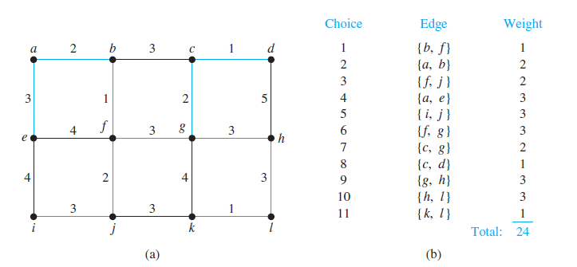

Slide 44
Kruskal’s Algorithm
Work with edges, rather than nodes
Two steps:
Sort edges by increasing edge weight
Select the first |V| – 1 edges that do not generate a cycle

Slide 45
Walk-Through
Consider an undirected, weight graph
F
3
C
10
A
4
3
8
4
5
B
6
D
4
4
H
2
1
3
G
E
3

Slide 46
Sort the edges by increasing edge weight
F
3
C
edge | d_{v}
(D,E) | 1
(D,G) | 2
(E,G) | 3
(C,D) | 3
(G,H) | 3
(C,F) | 3
(B,C) | 4
edge | d_{v}
(B,E) | 4
(B,F) | 4
(B,H) | 4
(A,H) | 5
(D,F) | 6
(A,B) | 8
(A,F) | 10
10
A
4
3
8
4
5
B
6
D
4
4
H
2
1
3
G
E
3

Slide 47
Select first |V|–1 edges which do not generate a cycle
F
3
C
edge | d_{v}
(D,E) | 1 | √
(D,G) | 2
(E,G) | 3
(C,D) | 3
(G,H) | 3
(C,F) | 3
(B,C) | 4
edge | d_{v}
(B,E) | 4
(B,F) | 4
(B,H) | 4
(A,H) | 5
(D,F) | 6
(A,B) | 8
(A,F) | 10
10
A
4
3
8
4
5
B
6
D
4
4
H
2
1
3
G
E
3

Slide 48
Select first |V|–1 edges which do not generate a cycle
F
3
C
edge | d_{v}
(D,E) | 1 | √
(D,G) | 2 | √
(E,G) | 3
(C,D) | 3
(G,H) | 3
(C,F) | 3
(B,C) | 4
edge | d_{v}
(B,E) | 4
(B,F) | 4
(B,H) | 4
(A,H) | 5
(D,F) | 6
(A,B) | 8
(A,F) | 10
10
A
4
3
8
4
5
B
6
D
4
4
H
2
1
3
G
E
3

Slide 49
Select first |V|–1 edges which do not generate a cycle
F
3
C
edge | d_{v}
(D,E) | 1 | √
(D,G) | 2 | √
(E,G) | 3 | χ
(C,D) | 3
(G,H) | 3
(C,F) | 3
(B,C) | 4
edge | d_{v}
(B,E) | 4
(B,F) | 4
(B,H) | 4
(A,H) | 5
(D,F) | 6
(A,B) | 8
(A,F) | 10
10
A
4
3
8
4
5
B
6
D
4
4
H
2
1
3
G
E
3
Accepting edge (E,G) would create a cycle

Slide 50
Select first |V|–1 edges which do not generate a cycle
F
3
C
edge | d_{v}
(D,E) | 1 | √
(D,G) | 2 | √
(E,G) | 3 | χ
(C,D) | 3 | √
(G,H) | 3
(C,F) | 3
(B,C) | 4
edge | d_{v}
(B,E) | 4
(B,F) | 4
(B,H) | 4
(A,H) | 5
(D,F) | 6
(A,B) | 8
(A,F) | 10
10
A
4
3
8
4
5
B
6
D
4
4
H
2
1
3
G
E
3

Slide 51
Select first |V|–1 edges which do not generate a cycle
F
3
C
edge | d_{v}
(D,E) | 1 | √
(D,G) | 2 | √
(E,G) | 3 | χ
(C,D) | 3 | √
(G,H) | 3 | √
(C,F) | 3
(B,C) | 4
edge | d_{v}
(B,E) | 4
(B,F) | 4
(B,H) | 4
(A,H) | 5
(D,F) | 6
(A,B) | 8
(A,F) | 10
10
A
4
3
8
4
5
B
6
D
4
4
H
2
1
3
G
E
3

Slide 52
Select first |V|–1 edges which do not generate a cycle
F
3
C
edge | d_{v}
(D,E) | 1 | √
(D,G) | 2 | √
(E,G) | 3 | χ
(C,D) | 3 | √
(G,H) | 3 | √
(C,F) | 3 | √
(B,C) | 4
edge | d_{v}
(B,E) | 4
(B,F) | 4
(B,H) | 4
(A,H) | 5
(D,F) | 6
(A,B) | 8
(A,F) | 10
10
A
4
3
8
4
5
B
6
D
4
4
H
2
1
3
G
E
3

Slide 53
Select first |V|–1 edges which do not generate a cycle
F
3
C
edge | d_{v}
(D,E) | 1 | √
(D,G) | 2 | √
(E,G) | 3 | χ
(C,D) | 3 | √
(G,H) | 3 | √
(C,F) | 3 | √
(B,C) | 4 | √
edge | d_{v}
(B,E) | 4
(B,F) | 4
(B,H) | 4
(A,H) | 5
(D,F) | 6
(A,B) | 8
(A,F) | 10
10
A
4
3
8
4
5
B
6
D
4
4
H
2
1
3
G
E
3

Slide 54
Select first |V|–1 edges which do not generate a cycle
F
3
C
edge | d_{v}
(D,E) | 1 | √
(D,G) | 2 | √
(E,G) | 3 | χ
(C,D) | 3 | √
(G,H) | 3 | √
(C,F) | 3 | √
(B,C) | 4 | √
edge | d_{v}
(B,E) | 4 | χ
(B,F) | 4
(B,H) | 4
(A,H) | 5
(D,F) | 6
(A,B) | 8
(A,F) | 10
10
A
4
3
8
4
5
B
6
D
4
4
H
2
1
3
G
E
3

Slide 55
Select first |V|–1 edges which do not generate a cycle
F
3
C
edge | d_{v}
(D,E) | 1 | √
(D,G) | 2 | √
(E,G) | 3 | χ
(C,D) | 3 | √
(G,H) | 3 | √
(C,F) | 3 | √
(B,C) | 4 | √
edge | d_{v}
(B,E) | 4 | χ
(B,F) | 4 | χ
(B,H) | 4
(A,H) | 5
(D,F) | 6
(A,B) | 8
(A,F) | 10
10
A
4
3
8
4
5
B
6
D
4
4
H
2
1
3
G
E
3

Slide 56
Select first |V|–1 edges which do not generate a cycle
F
3
C
edge | d_{v}
(D,E) | 1 | √
(D,G) | 2 | √
(E,G) | 3 | χ
(C,D) | 3 | √
(G,H) | 3 | √
(C,F) | 3 | √
(B,C) | 4 | √
edge | d_{v}
(B,E) | 4 | χ
(B,F) | 4 | χ
(B,H) | 4 | χ
(A,H) | 5
(D,F) | 6
(A,B) | 8
(A,F) | 10
10
A
4
3
8
4
5
B
6
D
4
4
H
2
1
3
G
E
3

Slide 57
Select first |V|–1 edges which do not generate a cycle
F
3
C
edge | d_{v}
(D,E) | 1 | √
(D,G) | 2 | √
(E,G) | 3 | χ
(C,D) | 3 | √
(G,H) | 3 | √
(C,F) | 3 | √
(B,C) | 4 | √
edge | d_{v}
(B,E) | 4 | χ
(B,F) | 4 | χ
(B,H) | 4 | χ
(A,H) | 5 | √
(D,F) | 6
(A,B) | 8
(A,F) | 10
10
A
4
3
8
4
5
B
6
D
4
4
H
2
1
3
G
E
3

Slide 58
Select first |V|–1 edges which do not generate a cycle
F
3
C
edge | d_{v}
(D,E) | 1 | √
(D,G) | 2 | √
(E,G) | 3 | χ
(C,D) | 3 | √
(G,H) | 3 | √
(C,F) | 3 | √
(B,C) | 4 | √
edge | d_{v}
(B,E) | 4 | χ
(B,F) | 4 | χ
(B,H) | 4 | χ
(A,H) | 5 | √
(D,F) | 6
(A,B) | 8
(A,F) | 10
A
3
4
5
B
D
H
2
1
}
3
G
E
not
considered
Done
Total Cost = Σ d_{v} = 21

Slide 59
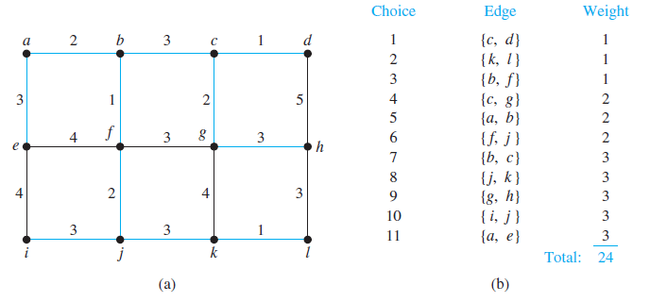

Slide 60
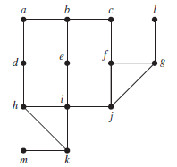
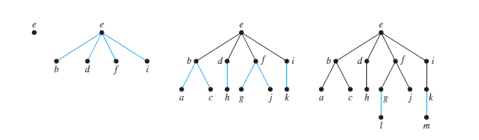
Breadth first search (BFS)
solution

Slide 61
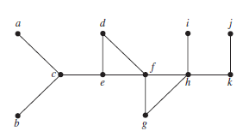
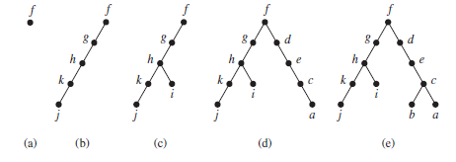
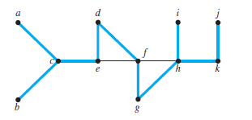
Depth first search (DFS)
solution

